Slide 1
ASP.NET - Server Controls

Slide 2
Objectives
At the end of this session you will be able to
  Define a server control and its types.
  Compare HTML controls with web server controls.
  Create web pages using intrinsic web server controls.
  Perform validation on the data on web page using validation controls.
  Use List controls to display a list of data on web page
  Use rich controls like AdRotator,Calendar and Multiview.
Notes:
Describe
Name
List
Use
Compare / contrast

Slide 3
Server Control
Visual component on a web form that run on server.
  Base class is System.Web.UI.Control
  Used in ASP.NET pages and code behind classes.
  All ASP.NET server controls use the runat=server attribute.
  ViewState saved automatically
  Functionality of the control is defined in the processes called Event Procedures which are invoked when the user performs the action.

Slide 4
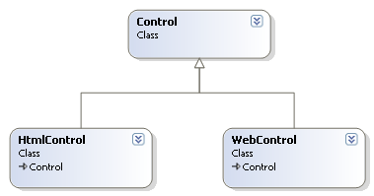
Types of Server Controls
HTML Server Controls
  Derived from HtmlControl class
Web Server Controls
  Derived from WebControl class
Notes:
There are different types of server controls available in ASP.NET. They can be basically of two types.
HTML Server Controls
Web Server Controls
HTML Server control
These controls are defined in System.Web.UI.HTMLControls namespace. The base class for these controls is HtmlControl class. They are HTML elements treated as text which can be easily interpreted by the browser. The logic corresponding to the control runs on client side by default. But by adding, runat = server attribute, they are converted to HTML server controls and are processed at server.
<input id="Text1" type="text" runat="server" />
Web Server Control
These controls are defined in System.Web.UI.WebControls namespace. The base class for this category of controls is WebControl class. These are defined like the one mentioned below.
<asp:TextBox ID="TextBox3" runat="server" Style="z-index: 100; left: 144px; position: absolute;
top: 199px" Width="144px"></asp:TextBox>
They essentially have runat=“server” attribute defined. They are processed only on server. This category includes not only simple controls like textbox, button, label but also special purpose controls like calendar, adrotator, etc. When the web page is rendered to the browser, these server controls determine which browser requested the page. Accordingly the HTML is delivered.

Slide 5
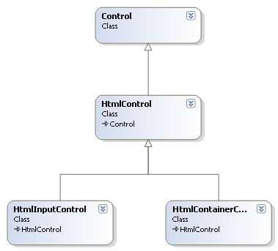
HTML Server controls
About 20 distinct HTML server controls.
Can be categorized as
  Input Controls represented by HtmlInputControl class
  Container Controls represented by HtmlContainerControl class
Notes:
HTML Server Controls include the runat=“server” attribute. They reside in <form . . .> . . . </form> tag. These controls can be adjusted to process at browser or web server depending on the requirement.
HtmlControl class
It is the base class for all HTML server controls. It exposes a number of properties like Disabled,Style,TagName,etc.
(page 119) table
There are about 20 HTML server control classes. They can be further categorized as follows
Input Controls derived from HtmlnputControl class
This category includes checkboxes, textboxes, buttons and listboxes. These are generated as <input> tag.
<input type = “text”> represents a text box
<input type =“submit”> represents a button.
The properties of HtmlInputControl class are:
//insert a table here page 120
2. Container controls derived from HtmlContainerControl Class
An HTML tag that has opening and closing tag like <a> ….</a>. This tag wraps text or image.
The properties of HtmlContainerControl class are:
Page 119 table

Slide 6
HTML Server Controls
<input id="Enter" type="button" value="Enter"
OnServerClick="Enter_Click" runat="server">
<asp:AdRotator ID="AdRotator1" runat="server" AdvertisementFile="~/XMLFile.xml" Height="197px"
Style="z-index: 100; left: 71px; position: absolute; top: 98px" Width="175px" OnAdCreated="AdRotator1_AdCreated" />

Slide 7
Web Server Controls
Defined specifically for ASP.NET.
runat=“server” is added by default when the control is added to the web page.
Categorized as
    Intrinsic controls
    Validation controls
    List Controls
    Rich Controls
Notes:
Web Server Controls are specifically designed for ASP.NET. They are designed for processing at server side only. The controls inherit from WebControl class and have their own properties and events defined.
Web server controls are further categorized as follows. Intrinsic Controls
They match HTML controls like textbox,label,buttons.
Validation Controls
They define logic that tests the correctness user’s input customized according to the requirement.
List Controls
These controls can display list of data on ASP.Net web page.
Rich Controls
They are complex controls that include multiple functionality like the adrotator, calendar,etc.

Slide 8
Intrinsic Web Server controls
Inherited from WebControl class.
Provides same functionality as HTML server controls.
Examples are
  textbox
  button
  checkbox
  hyperlink
  image
  imagebutton
  linkbutton
  label
  listbox
  radiobutton
  panel
Notes:
Intrinsic controls provide same functionality as that of HTML server controls. The following table illustrates the Intrinsic control, its declaration tag and the rendered HTML equivalent to be sent to the browser.
// table here from next slide

Slide 9
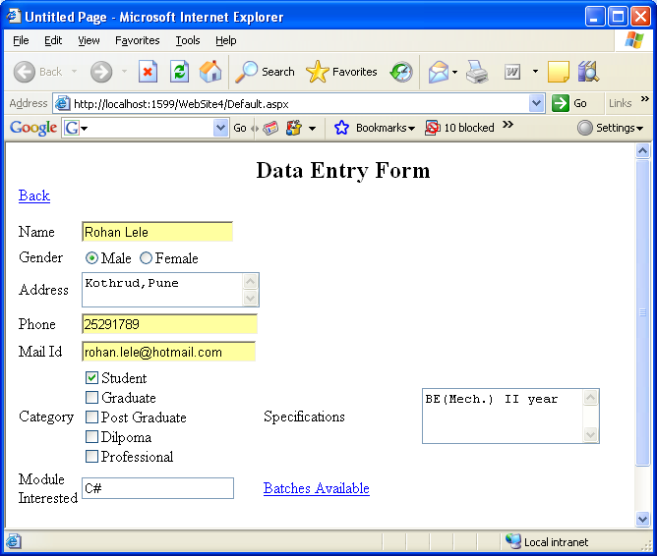
Data Entry Form
Student Form
Notes:
The web page shown above contains a a number of intrinsic controls. The page is designed to accept the enquiry details of a client for a particular course.
How is the code implemented for server controls.
The code can be implemented as inline, as a part of <script> section in the same design file. The code can also be a part of code behind file.
Writing Inline code
Inline code is written in a separate section in .aspx file. The purpose is just readability of code otherwise it can exist anywhere on page.
Consider the example on the slide.
<HTML>
<asp:Button id = “submit_btn” runat = “server”/>
. . .
</HTML>
<SCRIPT Language=“c#” runat =“server”>
private void submit_btn(object sender,System.EventArgs e)
{
. . . .
}
</SCRIPT>
The language used could be C# or VB.NET or JavaScript.
Client side event procedures can be written using JavaScript for HTML controls only. They can be used for performing a particular textbox before submitting it to the server.
Web server controls require server side processing code. The code is processed when the page is submitted to the web server with postback or autopostback. Since this requires a round trip to the server, events that occur frequently like mouse or key events
Writing Code in code behind files
The server side code is more convenient to write and read in code behind files. For the same button shown above on the web page, an event procedure can be written in .aspx.cs file of that page.
protected void Button1_Click(object sender, System.EventArgs e)
{
. . . . .
}
The controls can be read or written to in the server side event procedures. The controls are referred using ID property of the web server controls. On the click of submit button on the page shown above, apart from the other logic if “Hello Rohan you are registered!!!” has to be displayed, following code can be written.
string str = “Hello ” + txtName.Text + “ you are registered!!!”;
Response.Write(str);
Here txtName is the ID of textbox on the form which accepts the name.

Slide 10
List controls
Inherited from System.Web.UI.WebControls.ListControl class
Can be either bound to a data source or programmatically filled with items.
Examples are
  DropDownList
  ListBox
  CheckBoxList
  RadioButtonList
  BulletedList
Allow multiple selection except BulletedList and RadioButtonList which displays static text.
Notes:
List Controls display data from a data source. This data could be a hard coded data at design time or fetched from the data source( database, business object, XML file or any other data source. All the list controls support the same set of properties and methods as other web controls. They inherit from System.Web.UI.WebControls.ListControl class.
All the list controls are selectable except BulletedList. BulletedList displays static text. RadioButtonList and CheckBoxList controls render multiple checkboxes or option buttons. DropDownList and ListBox display a list of pre-defined or dynamically added values. The default event for all the controls is SelectedIndexChanged except for BulletedList whose default event is Click. These events are fired automatically if the autopostback property of the control is set to true. This causes page to post back and the events to fire.
Following table summarizes the list controls with their rendered HTML equivalent.
// table here from next slide

Slide 11
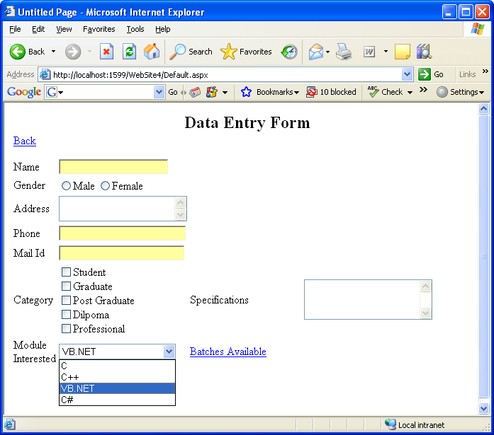
Modifying Data Entry Form
protected void Page_Load(object sender, EventArgs e)
{
if (!this.IsPostBack)
{
DropDownList1.Items.Add("C");
DropDownList1.Items.Add("C++");
DropDownList1.Items.Add("VB.NET");
DropDownList1.Items.Add("C#");
}
}
Notes:
The previous example is modified to hold modules in a dropdownlist box. The values are added through a page_load event. Since this event gets fired on every page request, the code would get executed each time. To avoid this, IsPostback property is used to control which code should execute only when page is requested for the first time.

Slide 12
Validation Web Server Controls
Declared on web form and bound to input control
More than one validator can be attached to a control.
CauseValidation property of button to be set to true for validation to take place.
Controls are
  RequiredFieldValidator
  CompareValidator
  RangeValidator
  CustomValidator
  RegularExpressionValidator
  ValidationSummary
Notes:
Validation Web Server Controls validate the user’s input on pre - determined conditions. These controls can be declared on the form and bound to any input control. More than one validation control can be bound to a control. For example, one validator can ensure that the field should not be empty and another validator to ensure correct type of data.
Validation is performed when the page is posted to the server. Every button has a CauseValidation property which can be set to true or false. If this property is set to false then the page gets posted and concerned events are fired normally. No validation takes place. As against this, if set to true validation will take place and appropriate error messages will be displayed. This is automatic validation.
Validation Controls are
RequiredFieldValidator
2. CompareValidator
CustomValidator
RegularExpressionValidator
ValidationSummary

Slide 13
Rich Web Server Controls
Exhibit complex interface elements
Rich controls provide an object model that has a complex HTML representation and also client side JavaScript.
Examples are
  AdRotator
  Calendar
  Multiview, View
  and so on . . .

Slide 14
AdRotator
  Randomly selects banner graphics from a list defined in an external XML file.
AdvertisementFile as XML file
<?xml version="1.0" encoding="utf-8" ?>
<Advertisements>
<Ad>
<ImageUrl>Best.jpg</ImageUrl>
<NavigateUrl>http://www.litware.com</NavigateUrl>
<AlternateText>About Litware Ltd.</AlternateText>
<Impressions>60</Impressions>
</Ad>
<Ad>
<ImageUrl>Test.jpg</ImageUrl>
<NavigateUrl>http://www.Cambridge.com</NavigateUrl>
<AlternateText>About Cambridge</AlternateText>
<Impressions>50</Impressions>
</Ad>
</Advertisements>
AdRotator defined
<asp:AdRotator ID="AdRotator1" runat="server" AdvertisementFile="~/XMLFile.xml" Height="197px“ Style="z-index: 100; left: 71px; position:absolute; top: 98px“ Width="175px" OnAdCreated="AdRotator1_AdCreated" />
Notes:
Steps
Define the XML schedule file with <Ad> tag and its properties defined
Specify the AdvertisementFile value in the AdRotator definition in Page design view.
Additionally AdCreated event can be trapped.

Slide 15
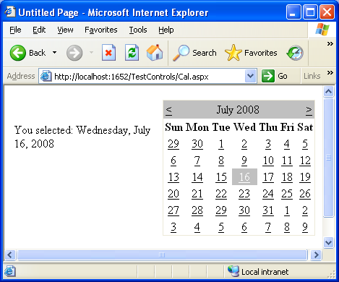
Calendar
<asp:Calendar ID="Calendar1" runat="server" OnSelectionChanged="Calendar1_SelectionChanged">
</asp:Calendar>
protected void Calendar1_SelectionChanged(object sender, EventArgs e){
Label1.Text = "You selected: " + Calendar1.SelectedDate.ToLongDateString();
}

Slide 16
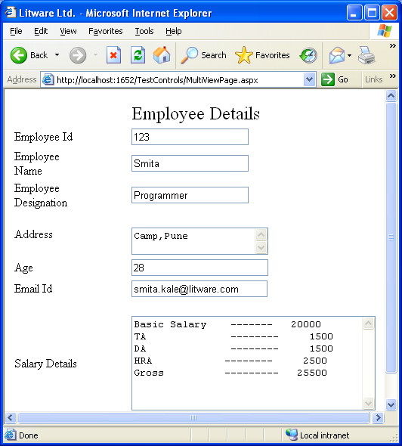
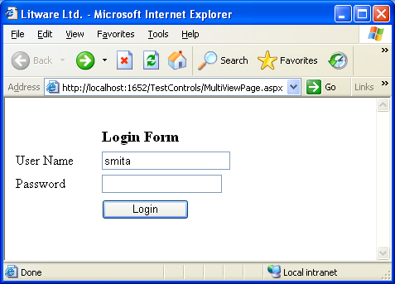
Multiview
<asp:MultiView ID="MultiView1" runat="server" ActiveViewIndex="0">
<asp:View ID="View1" runat="server">
. . . . .
</asp:View>
<asp:View ID="View2" runat="server">
. . . . .
</asp:View>
</asp:MultiView></div>

Slide 17
Selecting the control
Use HTML server controls if
  HTML - like object model is preferred.
  Web Form functionality is required while working with HTML pages.
  If large amount of client side processing is required.
Use Web server controls if
  Object-oriented programming is required.
  Rich controls like AdRotator, Calendar, etc. are required to get specific functionality.
  Request response cycles are affordable due to server side processing.

Slide 18
Quick Recap . . .
The base class for any server controls is System.Web.UI.Control.
Validation controls like RequiredFieldValidator, CustomValidator, etc. are used to validate the user input.
Rich Server Controls like Adrotator, Multiview, etc. are defined as a single object but provide a complex functionality.

